Slide 1
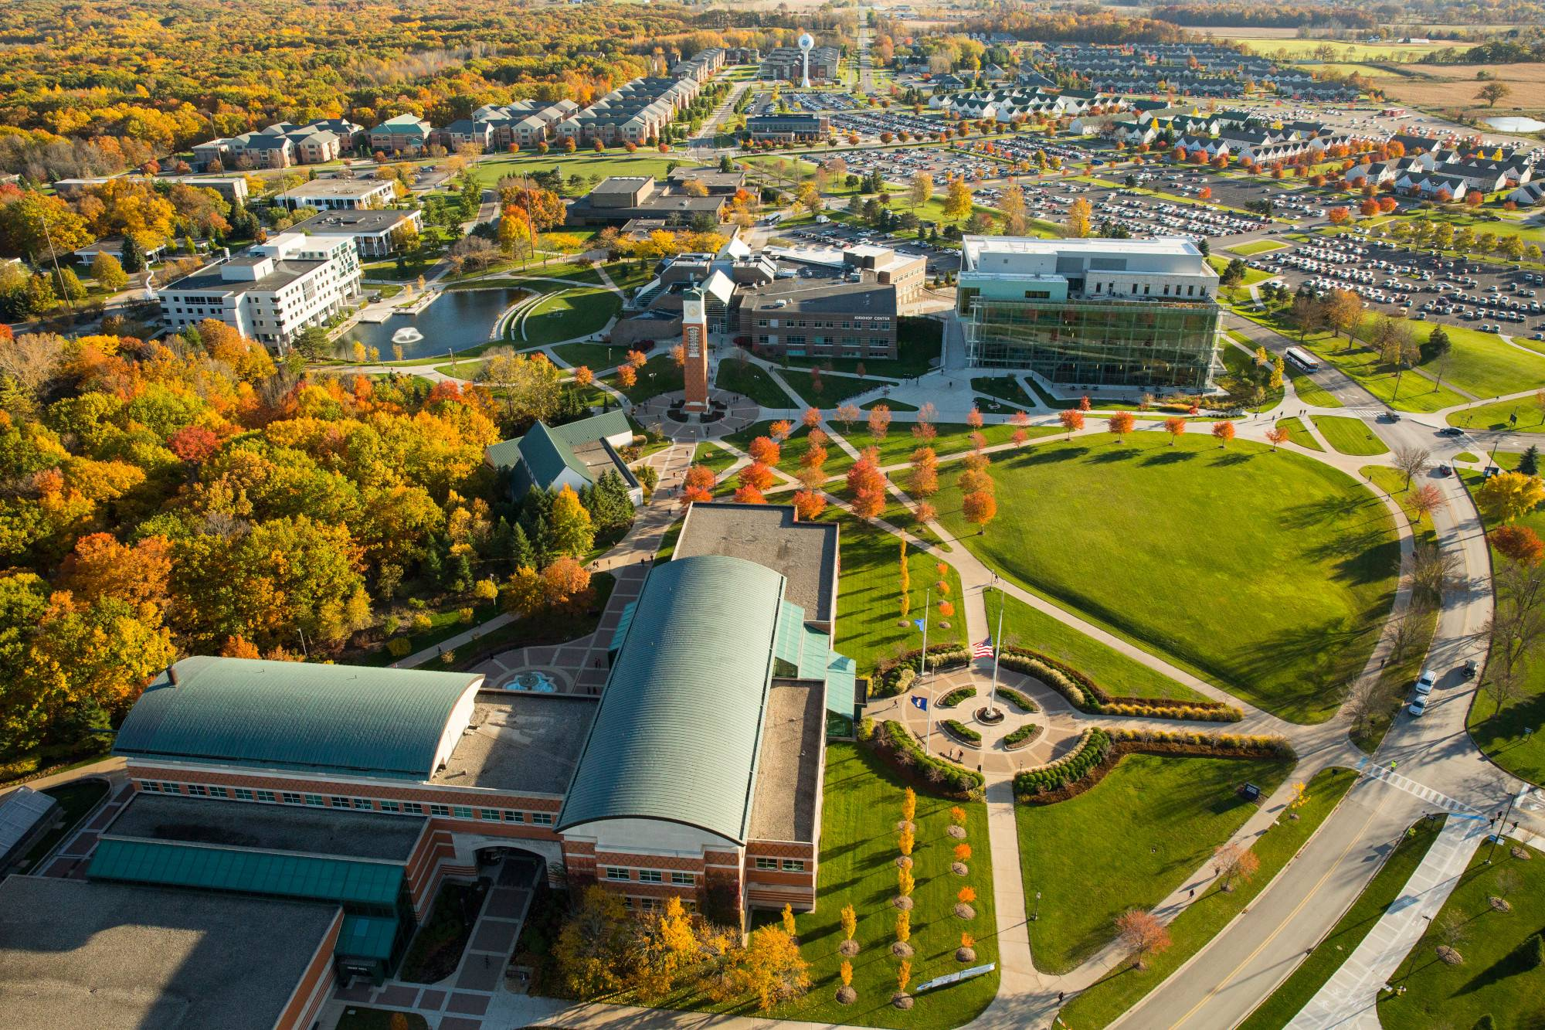

AI Benchmarks CCSC-MW Fall 2024 Conference Tutorial
Bill Nicholson
Assistant Professor Educator
Information Systems Program
Lindner College of Business
University of Cincinnati
nicholdw@ucmail.uc.edu
https://github.com/nicomp42/CCSCMW2024

Slide 2
Our focus today
Motivation for studying AI benchmarks
General overview of some benchmarks
More detailed examination of one specific benchmark
Analyze benchmark contents with Python
Questions

Slide 3
How do we characterize an AI model?
Anecdotally:
https://www.namepepper.com/chatgpt-users#exam-stats (totally random and unsubstantiated source)

Slide 4
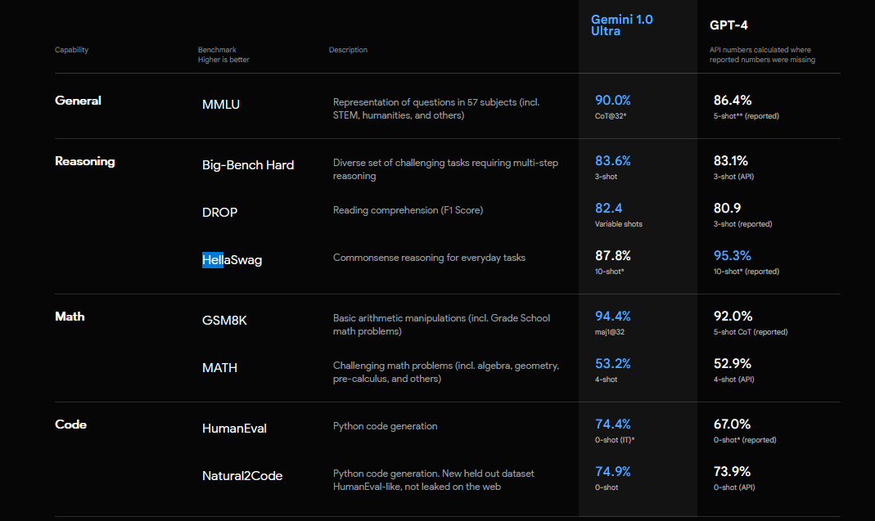
Leaderboard : Google Gemini vs GPT-4
https://deepmind.google/technologies/gemini/#introduction

Slide 5
General overview of our benchmarks
Appearing in LLM Leaderboards
Open Source and human-readable data files
Supported by published research
OpenAI, Allen Institute, U Chicago, Stanford, more
Content generated by AI, humans, Internet

Slide 6
Some Interesting Benchmarks
Big-Bench Hard: humans outperforming LLMs
FamRel: family relations
HellaSwag: context completion
ARC-Challenge: science
TruthfulQA: human misconceptions

Slide 7
Big-Bench Hard Benchmark
“Questions wherein humans outperformed LLMs”
6761 questions spanning 23 categories
Google Research, Stanford University
https://arxiv.org/pdf/2210.09261
[1]
https://github.com/suzgunmirac/BIG-Bench-Hard/blob/main/bbh/README.md

Slide 8
Some Categories
Logic
Sarcasm
Word Problems
Navigation
Snark
Penguins in a Table
Movie Recommendation
Big-Bench Hard Benchmark

Slide 9
Category : Penguins in a table
Here is a table where the first line is a header and each subsequent line is a penguin: name, age, height (cm), weight (kg) Louis, 7, 50, 11 Bernard, 5, 80, 13 Vincent, 9, 60, 11 Gwen, 8, 70, 15 For example: the age of Louis is 7, the weight of Gwen is 15 kg, the height of Bernard is 80 cm. We then delete the penguin named Bernard from the table.
How many penguins are less than 8 years old and weight less than 12 kg?
Big-Bench Hard Benchmark

Slide 10
Category : Penguins in a table (reformatted for humans)
Here is a table where the first line is a header
and each subsequent line is a penguin:
For example: the age of Louis is 7, the weight of Gwen is 15 kg, the height of Bernard is 80 cm. We then delete the penguin named Bernard from the table.
How many penguins are less than 8 years old and weight less than 12 kg?
name | age | height(cm) | weight(kg)
Louis | 7 | 50 | 11
Bernard | 5 | 80 | 13
Vincent | 9 | 60 | 11
Gwen | 8 | 70 | 15
One
Big-Bench Hard Benchmark

Slide 11
The data in this benchmark is JSON
{"input": "Here is a table where the first line is a header and each subsequent line is a penguin: name, age, height (cm), weight (kg) Louis, 7, 50, 11 Bernard, 5, 80, 13 Vincent, 9, 60, 11 Gwen, 8, 70, 15 For example: the age of Louis is 7, the weight of Gwen is 15 kg, the height of Bernard is 80 cm. We now add a penguin to the table:\nJames, 12, 90, 12\nHow many penguins are less than 8 years old and weight less than 12 kg?\nOptions:\n(A) 1\n(B) 2\n(C) 3\n(D) 4\n(E) 5",
"target": "(A)"},
Big-Bench Hard Benchmark

Slide 12
Analysis Strategy
Obtain the corpus of questions
Load the questions into a list of dictionaries and also a big text string.
Perform analysis
Select a random question
Compute readability indices
Build a word cloud
Compute word frequencies
Compute longest words
Find words not in the dictionary

Slide 13
Terminology
“Input” = the prompt given to the LLM.
“Target” = the possible responses for the input
“Question” = generically, the prompt along with all the possible responses.

Slide 14
We don’t care about
Validity of questions*
Correct/Incorrect answers
* https://www.surgehq.ai/blog/hellaswag-or-hellabad-36-of-this-popular-llm-benchmark-contains-errors

Slide 15
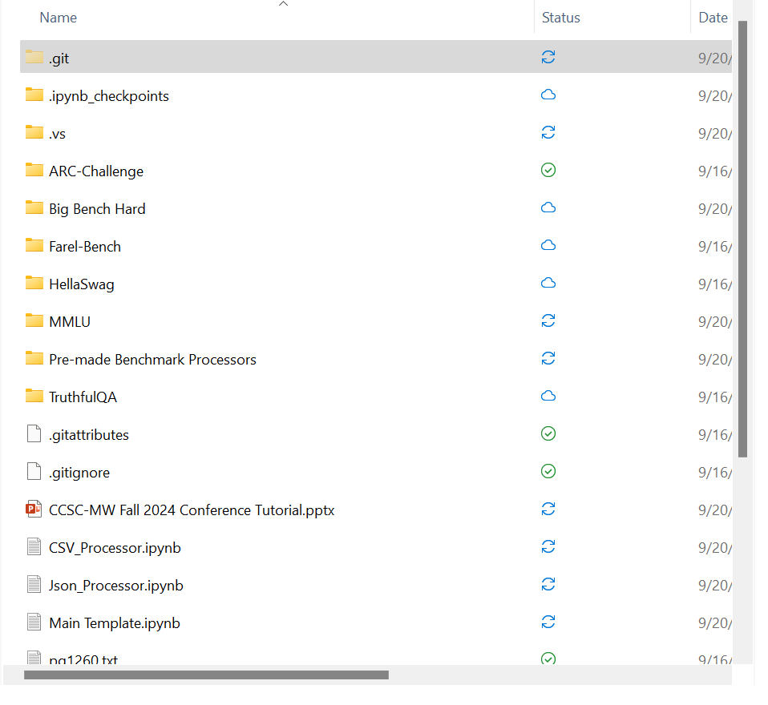
Directory Struture of the Project
Each benchmark has a directory structure:
A folder with the benchmark name, containing
Questions in a folder called data
Results in a folder called results

Slide 16
Our Software Architecture
Jupyter Notebooks
Each benchmark has an entry point module: Main {benchmark}.ipynb
https://github.com/nicomp42/CCSCMW2024

Slide 17
Consuming questions in different formats, from disparate sources.
In our code, we will build:
A list of dictionaries called questions with at least 2 keys:
Key “input”-> the text of the prompt
Key “target” -> the text of all the possible responses
A humongous string called text
All the questions appended together.
Some cleanup, but not much.

Slide 18
Build your own benchmark processor
Create the directory structure
Add a processor class to load the original data
Json_Processor.ipynb, or
CSV_Processor.ipynb
Start with a copy of Main Template.ipynb
Follow the “ToDo”s in that notebook
Run the notebook, look in the results folder

Slide 19
Language Analysis of Benchmark Questions
Benchmark | Gunning FOG Grade Level | Flesch Reading Ease Grade Level | Flesh-Kincaid Grade Level | Author’s Claim
ARC | 7th | 8th | 7.3 | 3rd to 9th Grade
GSM8K | < 6th | 6th | 3.5 | Grade school math problems
HellaSwag | 6th | 7th | 6.9 | Not addressed
TruthfulQA | < 6th | 7th | 4.7 | Not addressed
Big-Bench Hard | 6th | 7th | 7 | Not addressed
MMLU | 8 | 8 | 9.5 | Not addressed

Slide 20
Readability Scales
Fog Index | Reading level by grade
17 | College graduate
16 | College senior
15 | College junior
14 | College sophomore
13 | College freshman
12 | High school senior
11 | High school junior
10 | High school sophomore
9 | High school freshman
8 | Eighth grade
7 | Seventh grade
6 | Sixth grade
Reading Ease Score | School level (US) | Notes
100.00–90.00 | 5th grade | Very easy to read. Easily understood by an average 11-year-old student.
90.0–80.0 | 6th grade | Easy to read. Conversational English for consumers.
80.0–70.0 | 7th grade | Fairly easy to read.
70.0–60.0 | 8th & 9th grade | Plain English. Easily understood by 13- to 15-year-old students.
60.0–50.0 | 10th to 12th grade | Fairly difficult to read.
50.0–30.0 | College | Difficult to read.
30.0–10.0 | College graduate | Very difficult to read. Best understood by university graduates.
10.0–0.0 | Professional | Extremely difficult to read. Best understood by university graduates.

Slide 21
Future Work
Filter out common words prior to analysis
See function build_text_from_questions
Sentiment analysis
Read up on Word Clouds (what value do they provide?)
Investigate the impact on leaderboards from subtle changes to the questions.
Investigate grammar issues in questions
Semantic analysis
More data visualization

Slide 22

Gemini.google.com “Generate an image for the "questions" slide at the end of a powerpoint presentation”

Slide 23
Big-Bench Hard Benchmark
“Questions wherein humans outperformed LLMs ”
6761 questions spanning 23 categories
Google Research, Stanford University
[1]
https://github.com/suzgunmirac/BIG-Bench-Hard/blob/main/bbh/README.md

Slide 24
ARC Benchmark
“AI2 Reasoning Challenge”
“7,787 authentic, grade-school level, multiple-choice science questions
that are intended for question-answering.“
Allen Institute for Artificial Intelligence, Seattle, WA, U.S.A.
[2]

Slide 25
HellaSwag Benchmark
Harder Endings, Longer contexts, and Low-shot Activities for Situations With Adversarial Generations
tl;dr “Pick the best ending to the context.”
Sentence-Answer examples taken from sites Wikihow and ActivityNet
Paul G. Allen School of Computer Science & Engineering, University of Washington
Allen Institute for Artificial Intelligence
[1]

Slide 26
TruthfulQA Benchmark
“Measuring How Models Mimic Human Falsehoods”
817 questions spanning 38 categories, including health, law, finance and politics.
OpenAI, Univ of Oxford
[1]

